Slide 1

Capstone Project
Week 5 – Presentation
Where to locate a new sports bar

Slide 2
Comparison of Madison Square Garden (MSG) & Yankee Stadium (YS) bars.
The aim of this project was to find a suitable place within New York to set up a new sports bar.
The requirements for the new bar was to be within walking distance estimated to be a maximum of 17 minutes or around 1.5km away from the sporting arena in question. The bar also wanted to avoid other bars if possible.
The initial phase involved obtaining a list of all the bars within 1.5km around each site (MSG & YS).
Geographical coordinates were then found for all of the bars using Foursquare and then plotted onto a map using Folium.
The initial comparison can be seen below.

Slide 3
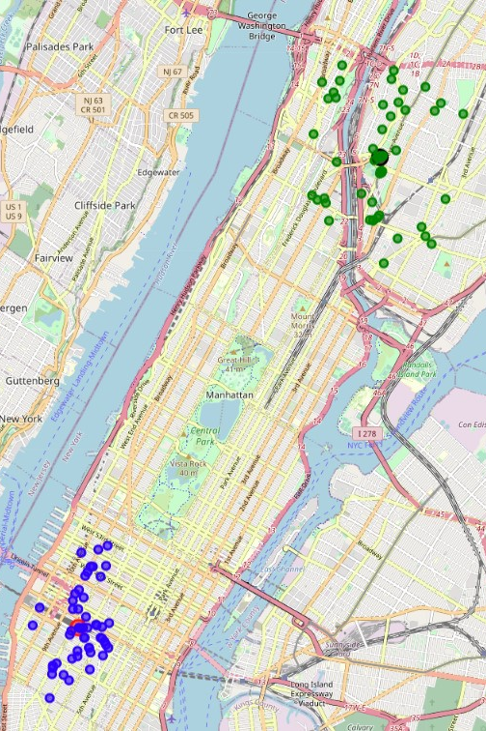
Folium map plots showing the distribution of bars.
The blue markers show the distribution of bars around Madison Square Garden.
The green markers show the distribution of bars around Yankee Stadium.

Slide 4
Focus on Yankee Stadium
The map showed a much tighter clustering of bars in close proximity to Madison Square Garden.
The distribution around the Yankee Stadium had a much looser distribution and also showed gaps where a new sports bar could be set up.
Following on from the initial findings, the focus was moved on to the bars around Yankee Stadium.
The bars were put into clusters using Kmeans clustering.
This produced three clear groups of clusters around the stadium as shown below.

Slide 5
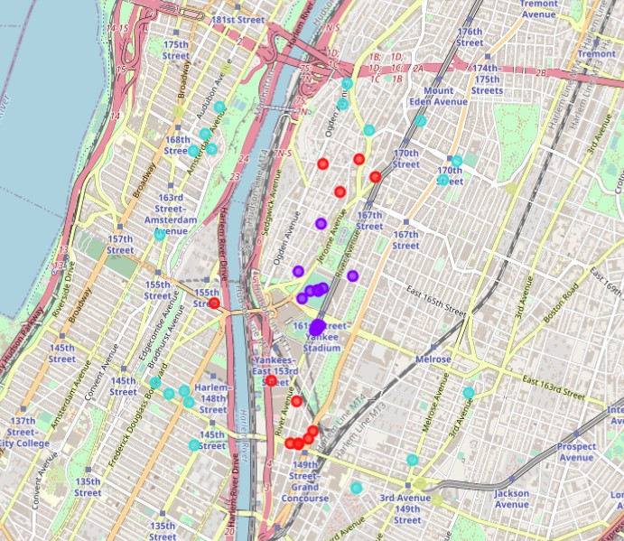
Clustering of bars around Yankee Stadium.
The clusters are show in three groups of red, purple and turquoise markers.
The purple markers are the closest to the stadium, whilst the turquoise markers are the furthest away.

Slide 6
Conclusion
The initial data led me to dismiss Madison Square Garden as the riskier option of the two due to high competition in the area.
The focus on Yankee Stadium led to the clustering of the data on bars which showed there was potential space for a new sports bar nearby.
The data plotted on the map suggests that the new sport bar should be set up to the east of Yankee Stadium where there is little competition.
It has also shown to avoid the area to the south of the stadium due to a tight cluster of bars in relatively close proximity.

